Slide 1


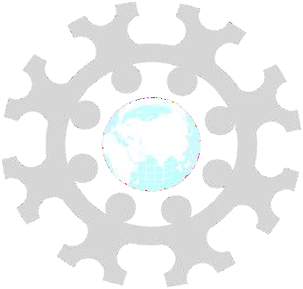
INSTITUTE: UIE (AIT-CSE)
CSS21: B.E. CSE (H) with specialization in Artificial Intelligence & Machine Learning
Advanced Machine Learning (20CSF-349)
Chapter 2.3.1 & 2.3.2:Neural Networks
Lecture 24 & 25:Introduction, Early Models & Perceptron Learning
By: Mr. Siddharth Kumar
DISCOVER . LEARN . EMPOWER

Slide 2
Advanced Machine Learning
Course Outcome
CO | Title
1 | Have a good understanding of the fundamental issues and challenges of machine learning: data, model selection, model complexity, etc.
2 | Appreciate the underlying mathematical relationships within and across Machine Learning algorithms and the paradigms of supervised and un-supervised learning
3 | Design and implement various machine learning algorithms in a range of real-world applications.
4 | Design and evaluate intelligent expert models for perception and prediction using machine learning algorithms
5 | Analyze and make use of machine learning algorithms-based applications using performance

Slide 3
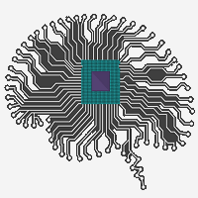
Neural Networks
Neural Networks is one of the most significant discoveries in history. This content provides basic and advanced concepts of Neural Networks.
The term "Artificial neural network" (ANN) refers to a biologically inspired sub-field of artificial intelligence modeled after the brain. An ANN is usually a computational network based on biological neural networks that construct the structure of the human brain.
A neural network is made of artificial neurons that receive and process input data. Data is passed through the input layer, the hidden layer, and the output layer.
Similar to a human brain has neurons interconnected to each other, artificial neural networks also have neurons that are linked to each other in various layers of the networks. These neurons are known as nodes.

Slide 4
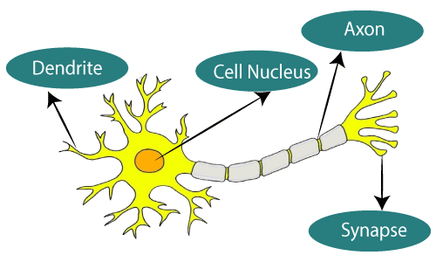
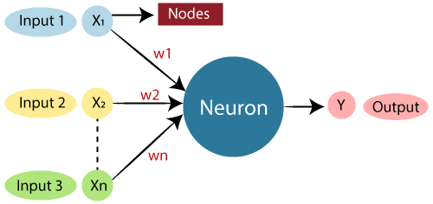
What is Artificial Neural Network?
The term "Artificial Neural Network" is derived from Biological neural networks that develop the structure of a human brain. Similar to the human brain that has neurons interconnected to one another, artificial neural networks also have neurons that are interconnected to one another in various layers of the networks. These neurons are known as nodes.
The given figure illustrates the typical diagram of Biological Neural Network and ANN looks
Typical diagram of Biological Neural Network
Typical ANN Looks

Slide 5
Dendrites from Biological Neural Network represent inputs in Artificial Neural Networks, cell nucleus represents Nodes, synapse represents Weights, and Axon represents Output.
Relationship between Biological neural network and artificial neural network:
Biological Neural Network | Artificial Neural Network
Dendrites | Inputs
Cell nucleus | Nodes
Synapse | Weights
Axon | Output
An Artificial Neural Network in the field of Artificial intelligence where it attempts to mimic the network of neurons makes up a human brain so that computers will have an option to understand things and make decisions in a human-like manner. The artificial neural network is designed by programming computers to behave simply like interconnected brain cells.

Slide 6
There are around 1000 billion neurons in the human brain. Each neuron has an association point somewhere in the range of 1,000 and 100,000. In the human brain, data is stored in such a manner as to be distributed, and we can extract more than one piece of this data when necessary from our memory parallelly. We can say that the human brain is made up of incredibly amazing parallel processors.
We can understand the artificial neural network with an example, consider an example of a digital logic gate that takes an input and gives an output. "OR" gate, which takes two inputs. If one or both the inputs are "On," then we get "On" in output. If both the inputs are "Off," then we get "Off" in output. Here the output depends upon input. Our brain does not perform the same task. The outputs to inputs relationship keep changing because of the neurons in our brain, which are "learning.“
Artificial Neural Networks are normally called Neural Networks (NN).
Neural networks are in fact multi-layer Perceptron's.

Slide 7
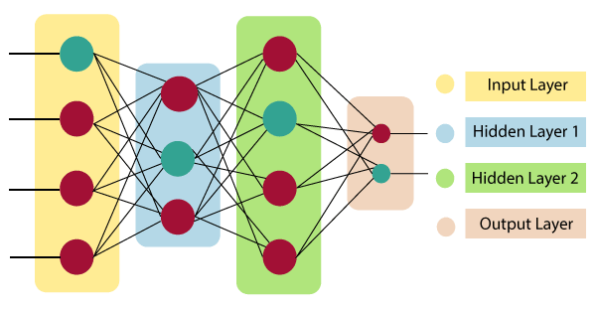
The architecture of an artificial neural network
To understand the concept of the architecture of an artificial neural network, we have to understand what a neural network consists of. In order to define a neural network that consists of a large number of artificial neurons, which are termed units arranged in a sequence of layers. Lets us look at various types of layers available in an artificial neural network.
Artificial Neural Network primarily consists of three layers:
Input Layer: As the name suggests, it accepts inputs in several different formats provided by the programmer.
Hidden Layer: The hidden layer presents in-between input and output layers. It performs all the calculations to find hidden features and patterns.
Output Layer: The input goes through a series of transformations using the hidden layer, which finally results in output that is conveyed using this layer.

Slide 8

The artificial neural network takes input and computes the weighted sum of the inputs and includes a bias. This computation is represented in the form of a transfer function.
It determines weighted total is passed as an input to an activation function to produce the output. Activation functions choose whether a node should fire or not. Only those who are fired make it to the output layer. There are distinctive activation functions available that can be applied upon the sort of tasks.
Advantages of Artificial Neural Network:
Parallel processing capability: Artificial neural networks have a numerical value that can perform more than one task simultaneously.
Storing data on the entire network: Data that is used in traditional programming is stored on the whole network, not on a database. The disappearance of a couple of pieces of data in one place doesn't prevent the network from working.

Slide 9
Capability to work with incomplete knowledge: After ANN training, the information may produce output even with inadequate data. The loss of performance here relies upon the significance of missing data.
Having a memory distribution: For ANN is to be able to adapt, it is important to determine the examples and to encourage the network according to the desired output by demonstrating these examples to the network. The succession of the network is directly proportional to the chosen instances, and if the event can't appear to the network in all its aspects, it can produce false output.
Having fault tolerance: Extortion of one or more cells of ANN does not prohibit it from generating output, and this feature makes the network fault-tolerance.
Disadvantages of Artificial Neural Network:
Assurance of proper network structure: There is no particular guideline for determining the structure of artificial neural networks. The appropriate network structure is accomplished through experience, trial, and error.

Slide 10
Unrecognized behavior of the network: It is the most significant issue of ANN. When ANN produces a testing solution, it does not provide insight concerning why and how. It decreases trust in the network.
Hardware dependence: Artificial neural networks need processors with parallel processing power, as per their structure. Therefore, the realization of the equipment is dependent.
Difficulty of showing the issue to the network: ANNs can work with numerical data. Problems must be converted into numerical values before being introduced to ANN.
How do ANNs work?
ANN can be best represented as a weighted directed graph, where the artificial neurons form the nodes. The association between the neurons outputs and neuron inputs can be viewed as the directed edges with weights. The Artificial Neural Network receives the input signal from the external source in the form of a pattern and image in the form of a vector. These inputs are then mathematically assigned by the notations x(n) for every n number of inputs.

Slide 11
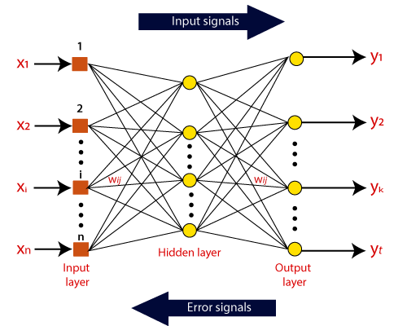
Afterward, each of the input is multiplied by its corresponding weights ( these weights are the details utilized by the artificial neural networks to solve a specific problem ). In general terms, these weights normally represent the strength of the interconnection between neurons inside the artificial neural network. All the weighted inputs are summarized inside the computing unit.
If the weighted sum is equal to zero, then bias is added to make the output non-zero or something else to scale up to the system's response. Bias has the same input, and weight equals to 1. Here the total of weighted inputs can be in the range of 0 to positive infinity. Here, to keep the response in the limits of the desired value, a certain maximum value is benchmarked, and the total of weighted inputs is passed through the activation function.

Slide 12
The activation function refers to the set of transfer functions used to achieve the desired output. There is a different kind of the activation function, but primarily either linear or non-linear sets of functions.
Early Models of Artificial Neural Network:
There are various types of Artificial Neural Networks (ANN) depending upon the human brain neuron and network functions, an artificial neural network similarly performs tasks. The majority of the artificial neural networks will have some similarities with a more complex biological partner and are very effective at their expected tasks. For example, segmentation or classification.
Hopfield Network
Kohonen Self Organizing Map
Associate Memory Network
Feedback ANN
Feed-Forward ANN

Slide 13
The history of neural networking arguably began in the late 1800s with scientific endeavors to study the activity of the human brain. In 1890, William James published the first work about brain activity patterns. In 1943, McCulloch and Pitts created a model of the neuron that is still used today in an artificial neural network. This model is segmented in two parts
A summation over-weighted inputs.
An output function of the sum.
In 1949, Donald Hebb published "The Organization of Behavior," which illustrated a law for synaptic neuron learning. This law, later known as Hebbian Learning in honor of Donald Hebb, is one of the most straight-forward and simple learning rules for artificial neural networks.
In 1951, Narvin Minsky made the first Artificial Neural Network (ANN) while working at Princeton.
In 1958, "The Computer and the Brain" were published, a year after Jhon von Neumann's death. In that book, von Neumann proposed numerous extreme changes to how analysts had been modeling the brain.

Slide 14
Perceptron Learning
Perceptron was created in 1958, at Cornell University by Frank Rosenblatt. The perceptron was an endeavor to use neural network procedures for character recognition. Perceptron was a linear system and was valuable for solving issues where the input classes were linearly separable in the input space.
In 1960, Rosenblatt published the book principles of neurodynamics, containing a bit of his research and ideas about modeling the brain.
Despite the early accomplishment of the perceptron and artificial neural network research, there were many individuals who felt that there was a constrained guarantee in these methods.
Among these were Marvin Minsky and Seymour Papert, whose 1969 book perceptrons were used to dishonor ANN research and focus attention on the apparent constraints of ANN work.
One of the limitations that Minsky and Papert's highlight was the fact that the Perceptron was not capable of distinguishing patterns that are not linearly separable in input space with a linear classification problem.

Slide 15
Regardless of the disappointment of Perceptron to deal with non-linearly separable data, it was not an inherent failure of the technology, but a matter of scale. Hecht-Nielsen showed a two-layer perceptron (Mark) in 1990 that is a three-layer machine that was equipped for tackling non-linear separation problems.
Perceptions introduced what some call the "quiet years," where ANN research was at a minimum of interest.
The backpropagation algorithm, initially found by Werbos in 1974, was rediscovered in 1986 with the book Learning Internal Representation by Error Propagation by Rumelhart, Hinton, and Williams. Backpropagation is a type of gradient descent algorithm used with artificial neural networks for reduction and curve-fitting.

Slide 16
References
T1: Mitchell T.M., Machine Learning, McGraw Hill (1997).
T2: Andreas C. Miller, Sarah Guido, Introduction to Machine Learning with Python, O’REILLY (2001).
Notes:
Introduction to Cyber Security (simplilearn.com)

Slide 17

THANK YOU

